Slide 1
PRONOUN ANTECEDENT

Slide 2
PRONOUN ANTECEDENT
What is a pronoun?
A pronoun takes the place of a noun and sometimes refers to a noun.
(I, me, he, she, herself, you, it, that, they, each, few, many, who, whoever, whose, someone, everybody, etc.)
Eg) We were playing poker with friends.
What is an antecedent?
An antecedent is a word, phrase, or clause to which a pronoun refers. It usually goes before the pronoun ("ante" means before).
Eg) Even though the party was fun, it was crowded.

Slide 3
pronoun-antecedent agreement
Pronoun antecedent agreement is when the pronoun agrees in number (referring to singular or plural) and person (referring to first, second, or third person) with its antecedent.
Everyone should make his or her own decision. (Singular)
The teacher forgot her book
A personal pronoun and its antecedent must agree in
Person—first (I, we), second (you), or third (he, she, it, they)
Gender—masculine (he), feminine (she), or neuter (it)
Number—singular or plural

Slide 4
Gender neutral pronouns
If gender is unknown or if you want to denote gender neutral, the pronouns they/them/their are becoming acceptable to refer to a singular person.
For Eg) I use “they” as my pronoun, so you could talk about me like this:
Zazo went to the store to get some guacamole supplies. They were having a lovely time until they lost their temper when they they couldn’t find any ripe avocados. They shouldn’t be too hard on themself, though. They’ll probably have better luck next time.
Language changes; it grows, expands, morphs and adapts to meet the needs of the modern day.

Slide 5
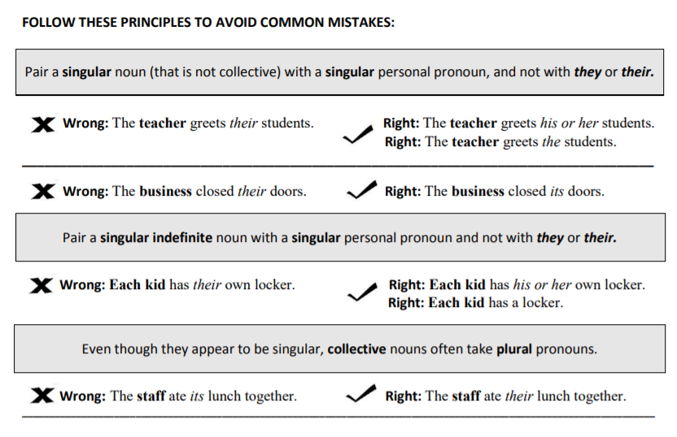

Slide 6
A phrase or clause between the subject and verb does not change the number of the antecedent.
The can of beans sits on its shelf.
Singular indefinite pronoun antecedents take singular pronoun referents.
Each of the clerks does a good deal of work in his/ her office.

Slide 7
Singular ‘they’
When referring to a generic person whose gender is unknown or irrelevant to the context, use the singular “they” as the pronoun. For example, if you use nouns like “person,” “individual,” or “everyone” or phrases like “every teacher” or “each nurse” in a sentence, use the appropriate form of the pronoun “they” as needed.
Each student submitted their art portfolio to the committee

Slide 8

Plural indefinite pronoun antecedents require plural referents.
Many clerks do a good deal of work in their office.
Some indefinite pronouns that are modified by a phrase may be either singular or plural.

Slide 9
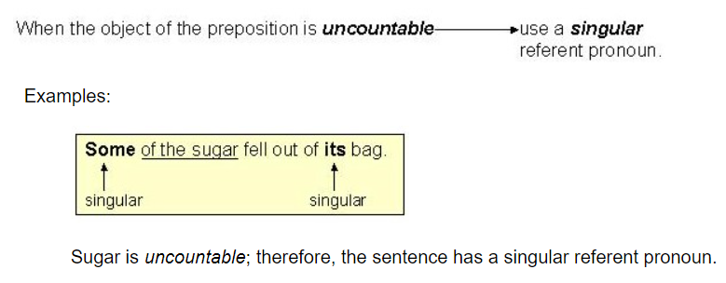

Slide 10
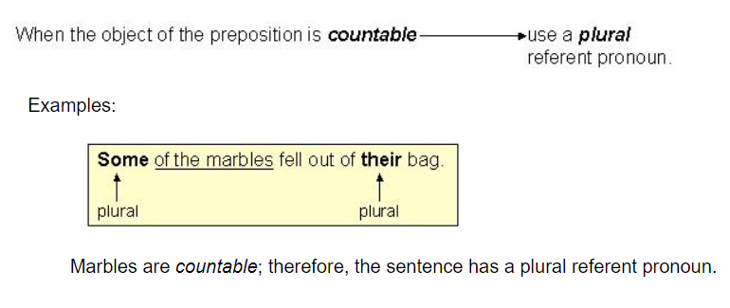

Slide 11
Two nouns joined by and always take a plural referent.
Leo and Jistin made their presentation.
With nouns joined by or/nor, the referent pronoun agrees with the antecedent closer to the pronoun.
Neither the singer nor the composers did their work.
Neither the composers nor the singer did his/ her work.

Slide 12
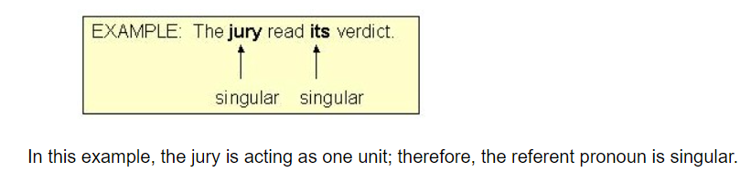
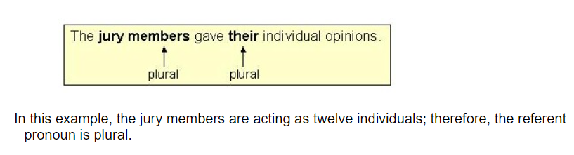
Collective Nouns (group, jury, crowd, team, etc.) may be singular or plural, depending on meaning.

Slide 13
Titles of single entities. (books, organizations, countries, etc.) take a singular referent.
The Grapes of Wrath made its characters seem real.
The United States cherishes its democracy.
Plural form subjects with a singular meaning take a singular referent. (news, measles, mumps, physics, etc)
The news has lost much of its sting two days later.

Slide 14


Every or Many a before a noun or a series of nouns requires a singular referent.
Every cow and horse had lost its life in the fire.
The number of vs A number of before a subject:

Slide 15
1. Jane and Sarah said (she, they) were too tired to skate any longer.
2. Either Bill or John will bring a sample of (his, their) own work.
3. Jane and Jill called (her, their) friend.
4. Either Janet or her friends will present (her, their) project.
5. Neither Mary nor Susan said (she, they) would be there.
Both John and Jim said (he, they) were not exercising regularly.
The jury was asked to return to (its, their) seats.
Neither John nor Bob was willing to admit that (he, they) had cheated.
The committee finally made (its, their) decision public.

Slide 16
When (John, John and Joe) slipped on the step, he fell
The (doctor, doctors) believed their diagnosis of a fracture was correct.
(A person, People) should always try to be helpful to his or her classmates.
(Jack, Jack and Mary) make regular contributions to their church.
Before students take a test, ____ should prepare adequately.

